Slide 1
NonHuman Primates in Research
Why use animals in research?
1. to advance basic scientific understanding
2. as models to study disease
3. to develop and test potential forms of treatment
As long as we believe that human life is more valuable than a fish, fly, mouse, or primate, research will be performed on animals before exposing humans to risk.

Slide 2
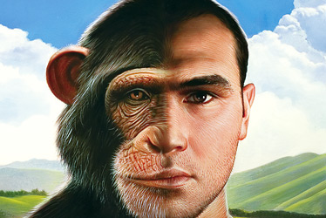
Primates as research animals
Primates are used because of their similarity to humans in physiology, neuroanatomy, reproduction, development, cognition, and social complexity
Primates account for 0.28% of all laboratory research animals (2010)

Slide 3
Research with primates
Atherosclerosis
Mental health disorders (depression, schizophrenia, OCD, addiction)
Cognitive aging
HIV/AIDS
Immunology
Reproduction
Neuroscience (Parkinson’s, Alzheimer’s)
Notes:
Macaques as model of diet-induced coronary artery atherosclerosis (hormones)

Slide 4
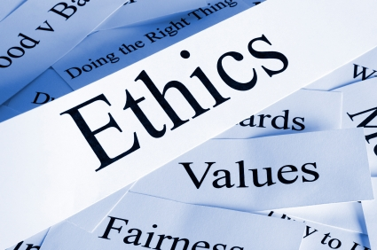
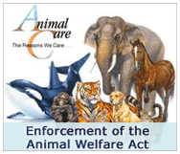
Regulation
Animal Welfare Act (1966, 1970, 1976, 1985, 1990, 2002, 2007, 2008) – minimum standards of care for primates in research
Guide for the Care and Use of Laboratory Animals (1966, 8th edition in 2011)
Institutional Animal Care and Use Committee

Slide 5
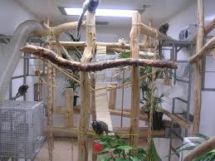
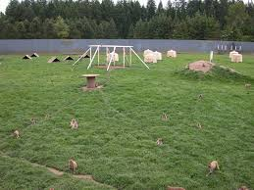
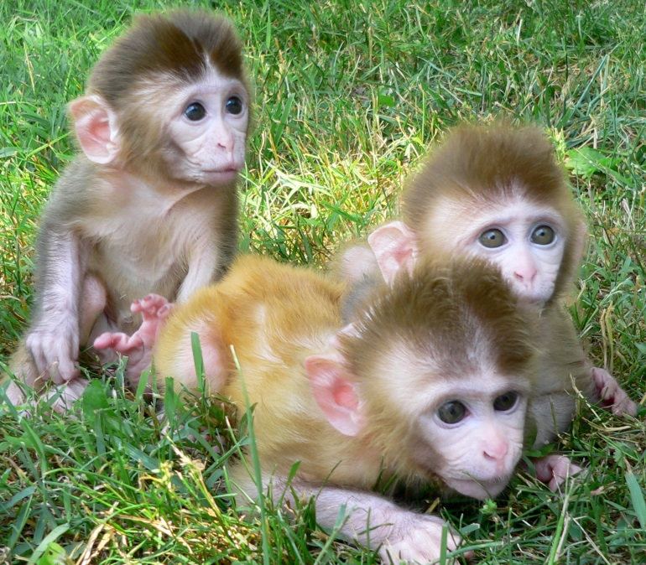
Research primates

Slide 6
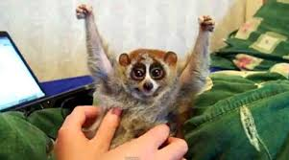
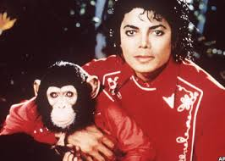
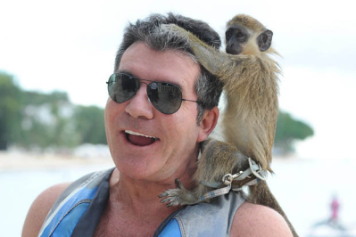
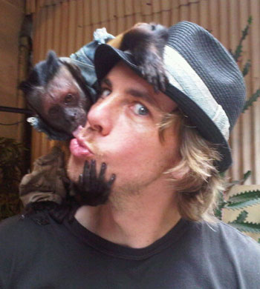
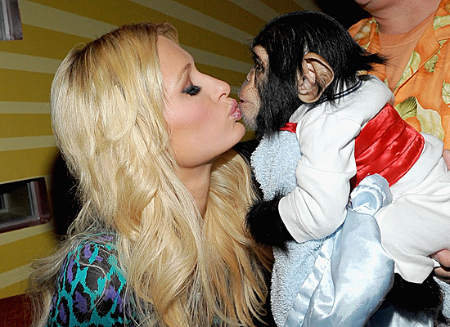
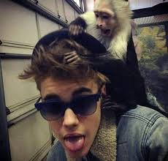
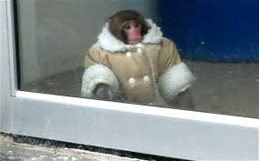
Do primates make good pets?

Slide 7
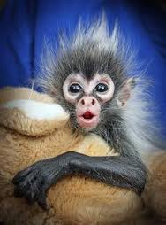
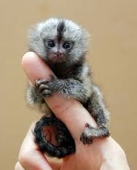
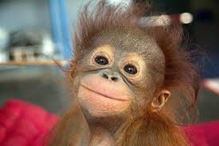
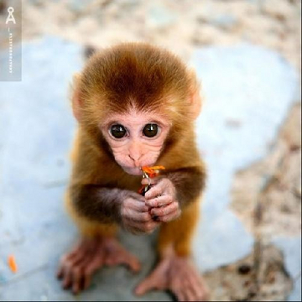
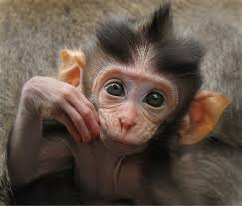
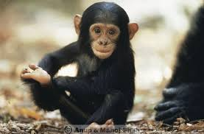
Pros
They’re really cute

Slide 8
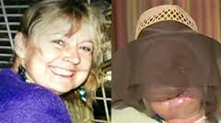
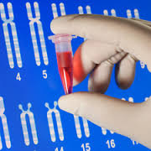
Cons
Dangerous - when mature very strong, very smart, and they bite
Transmit and contract contagious diseases
Social – it is cruel to make them live without their own kind

Slide 9
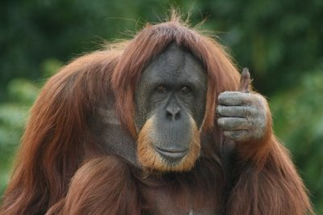
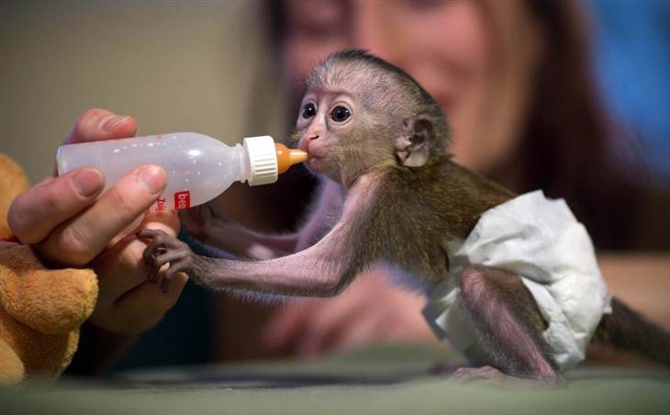
Cons
Live a long time (50 years +) - Difficult and expensive to look after them
Prone to destruction of environment (opposable thumbs!)
Impossible to house-train (and very excitable) – smell, mess

Slide 10
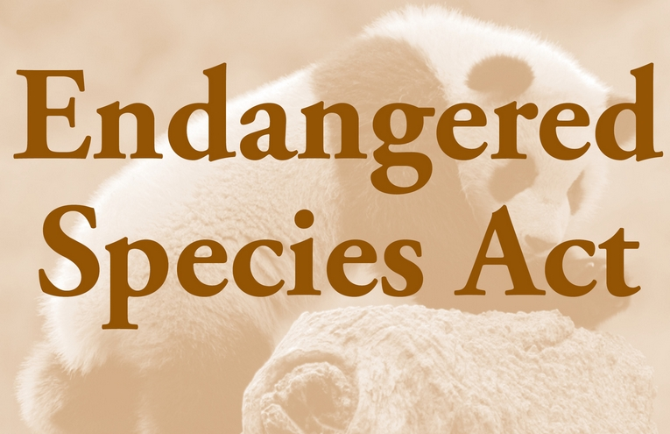
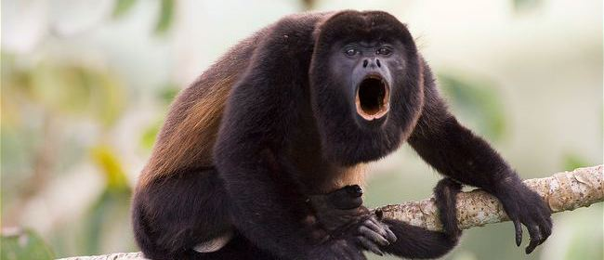
Cons
Illegal - Many species of primates are endangered. Many primates are protected by the Endangered Species Act (ESA) and state laws.
Sourcing from the wild means the mother/family has to be killed, further endangering wild primates

Slide 11
Summary
Pros | Cons
Cute | Dangerous
 | Transmit diseases
 | Cruel to be without their own kind
 | Expensive and difficult to care for
 | Destroy everything
 | Impossible to potty-train
 | Endangered animals
 | Illegal in many states

